Slide 1
Introduction to Time Series Analysis
Specificity of the subject analysis of time series;
Review of some tasks of time series analysis;
Time series types;
Specificity of time series models;
Types of time series analysis tasks;

Slide 2
Time Series Applications.
Time series is the set of the digitized indexed samples, in which each sample is connected with other in some relation. As a rule, there, statistical relation has place to be. Usually, Time series is considering as digitized sequential series of some values which are taken with some time-step. Often equidistant time-steps are used. Each series value can be called sample.
Time Series Analysis is one or a sequential set of method/algorithm to obtain (or estimate/predict) some of the series parameters (or features). Such features can be the further (previous) values of samples, some series parameters or its model at all. As a rule, the series is treated by statistically-based methods of analysis.

Slide 3
Time Series Applications.
The examples of the Time Series Analysis Applications are:
Economic Forecasting (Econometrics Analysis, Stock Marke Analysis, resource consumption).
Industrial machine diagnostic (for instance, machine fault diagnostic by vibration analysis).
Physical and chemical processes behavior prediction (for instance, sun spot prediction, weather forecasting).
Medical diagnostic (EEG, EMG and e.t.c.).
Signal processing (for instance, measurement signals from some industrial sensors).
Industrial systems control and diagnostic (for instance, forecast of products quality by sensors measurement results).
Time series database (TSDB) is a database optimized for time-stamped or time series data. Time series data are simply measurements or events that are tracked, monitored, down-sampled, and aggregated over time. A time series database is built specifically for handling metrics and events or measurements that are time-stamped.
A Time Series is a collection of observations (samples) indexed by time (in general another indexed variable can also be used). In common case time variable is discrete with uniformly taken time steps in which case we have a discrete time series. However, it could be continuous in this case we can say that we have continuous time series.

Slide 4
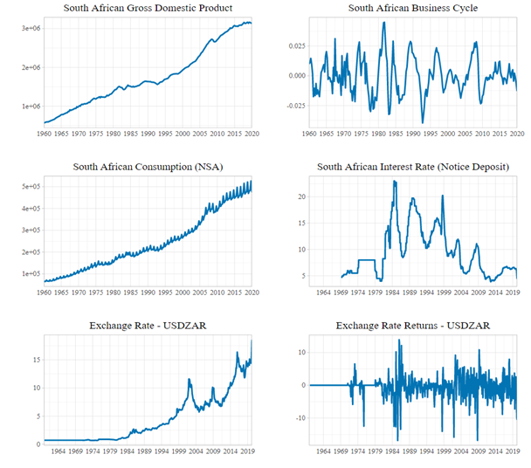
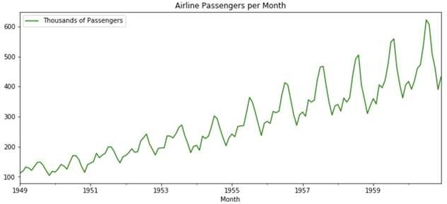
Examples of Time Series Applications. Economic Forecasting.

Slide 5
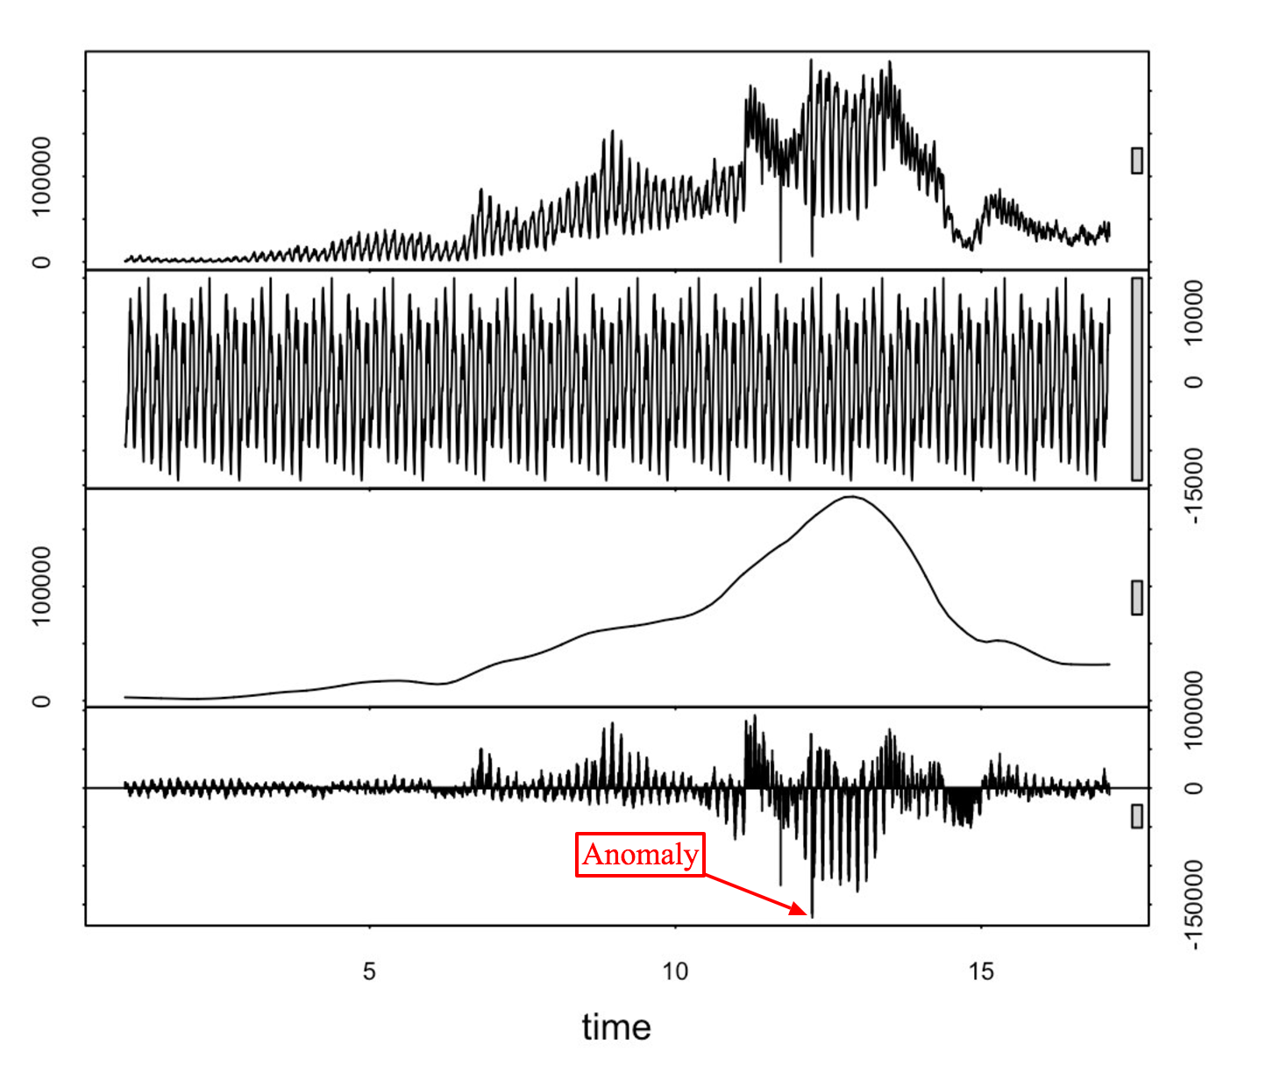
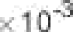
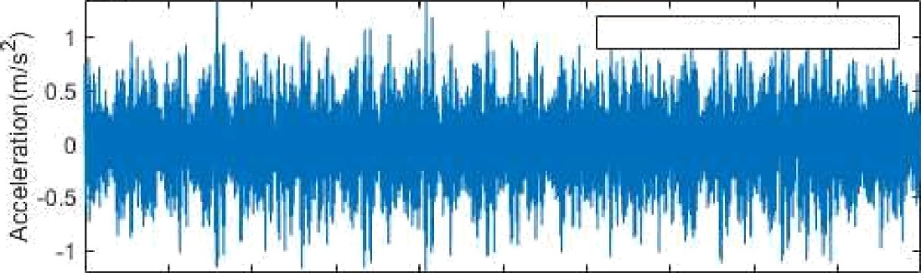
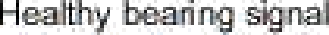
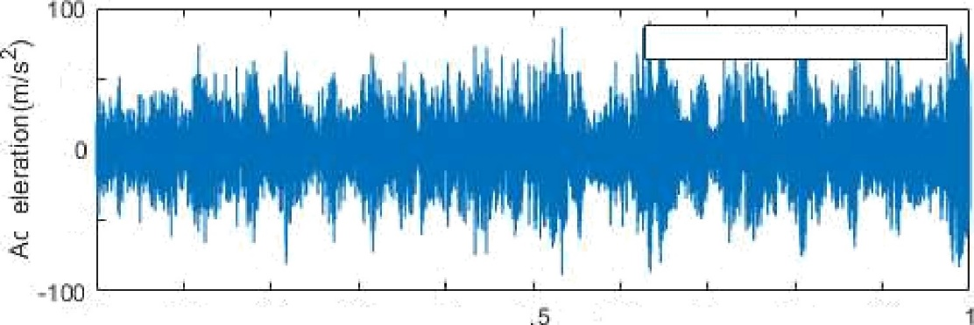
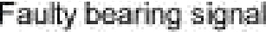
Examples of Time Series Applications. Industrial applications
Signal processing
Machine fault diagnostic
50
-50
0
0.1
0.2 0.3
0.4 0
0.6
0.7 0.8
0.9

Slide 6
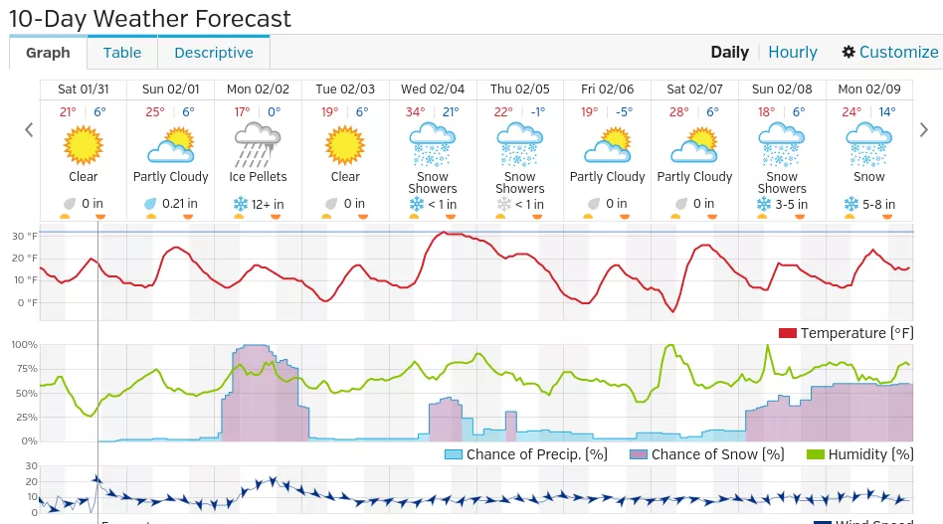
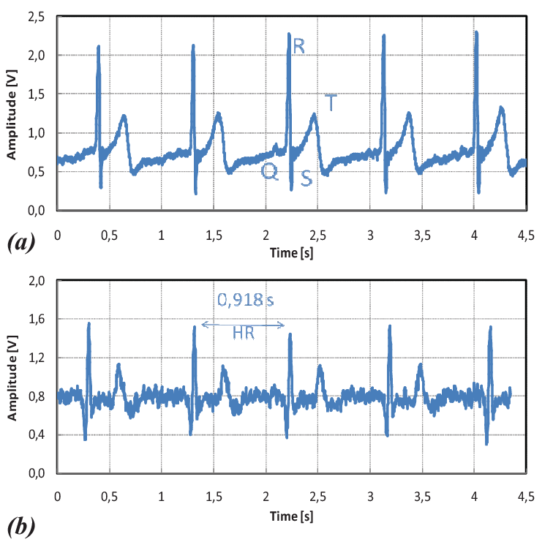
Examples of Time Series Applications. Other
Weather forecasting
Medical diagnostic

Slide 7
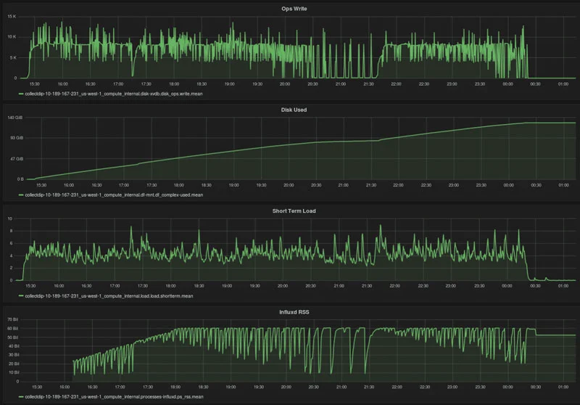
Examples of Time Series Applications
Time series data base
Medical diagnostic

Slide 8
About the time series data types
Interval: Interval scales provide information about order, and also ability to compare ranges; eg. temperature measured either on a Fahrenheit or Celsius scale: measured in Fahrenheit units, the difference between a temperature of 46 and 42 is the same as the difference between 72 and 68.
Nominal: This is qualitative, not quantitative; eg. Religious Preference: 1 = Buddhist, 2 = Muslim, 3 = Christian, 4 = Jewish, 5 = Other.
Ordinal: An ordinal scale that indicates ordering or direction in addition to providing nominal information; eg. Low/Medium/High or Faster/Slower are examples of ordinal levels of measurement. Ranking an experience as a "nine" on 1-10 scale tells us that it was higher than an experience ranked as a "six".
Ratio: In addition to possessing the qualities of nominal, ordinal, and interval scales, a ratio scale has an absolute zero, a point where none of the quality being measured exists; eg. income, years of work experience, number of children.

Slide 9
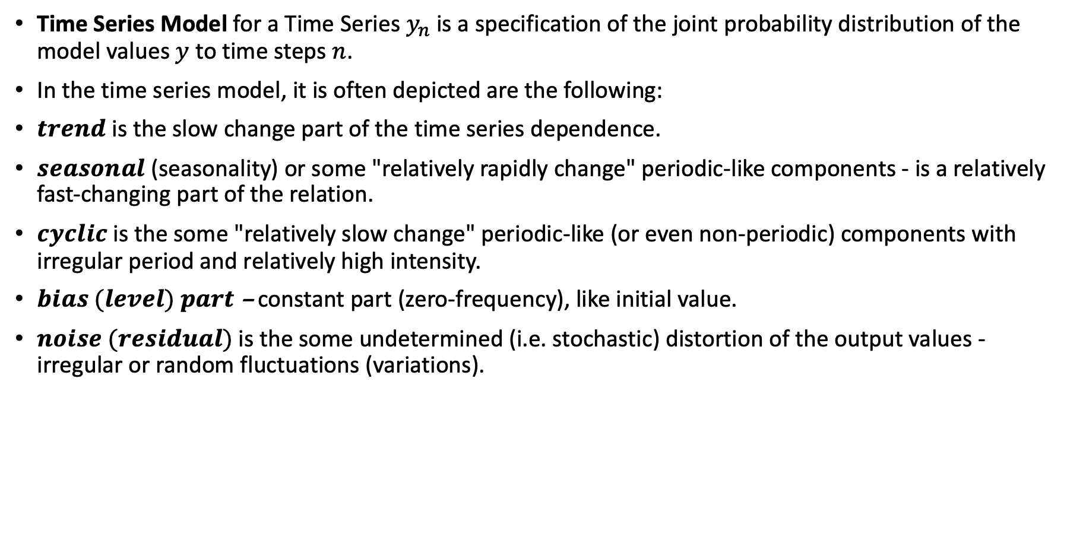
Time Series Models
Time Series Model for a Time Series $y_{n}$ is a specification of the joint probability distribution of the model values $y$ to time steps $n$.
In the time series model, it is often depicted are the following:
$trend$ is the slow change part of the time series dependence.
$seasonal$ (seasonality) or some "relatively rapidly change" periodic-like components - is a relatively fast-changing part of the relation.
$cyclic$ is the some "relatively slow change" periodic-like (or even non-periodic) components with irregular period and relatively high intensity.
$bias (level) part$– constant part (zero-frequency), like initial value.
$noise (residual)$is the some undetermined (i.e. stochastic) distortion of the output values - irregular or random fluctuations (variations).

Slide 10
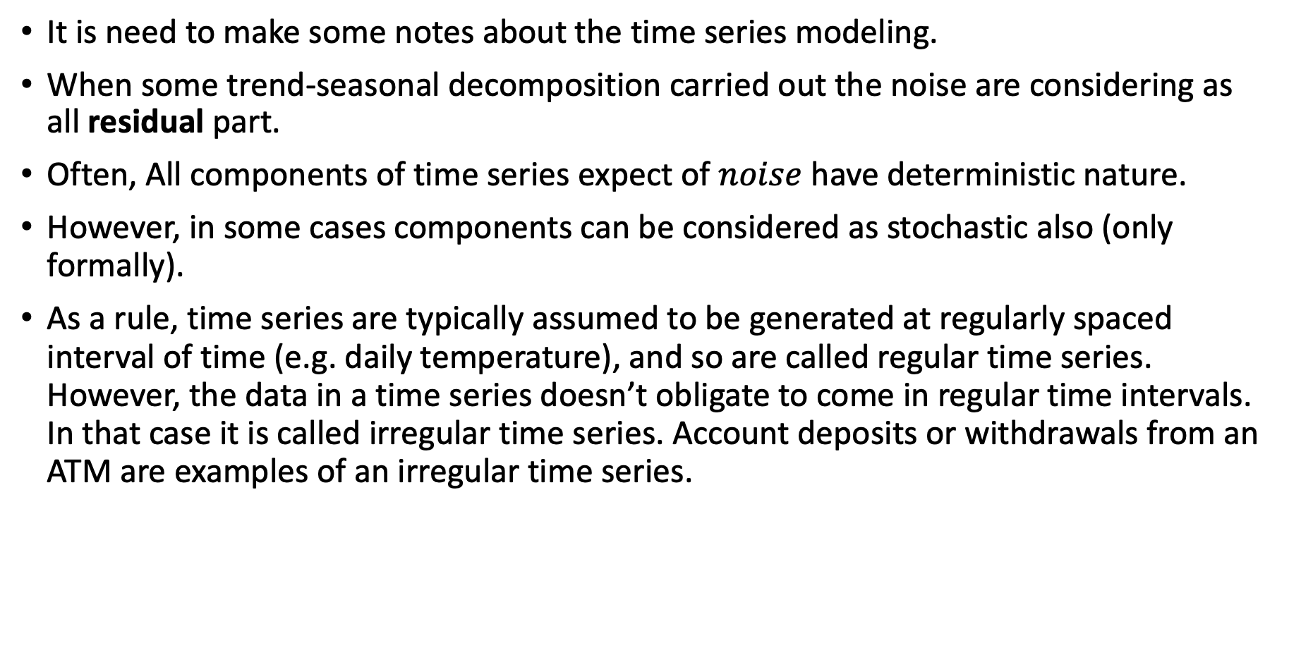
Time Series Models
It is need to make some notes about the time series modeling.
When some trend-seasonal decomposition carried out the noise are considering as all residual part.
Often, All components of time series expect of $noise$ have deterministic nature.
However, in some cases components can be considered as stochastic also (only formally).
As a rule, time series are typically assumed to be generated at regularly spaced interval of time (e.g. daily temperature), and so are called regular time series. However, the data in a time series doesn’t obligate to come in regular time intervals. In that case it is called irregular time series. Account deposits or withdrawals from an ATM are examples of an irregular time series.

Slide 11
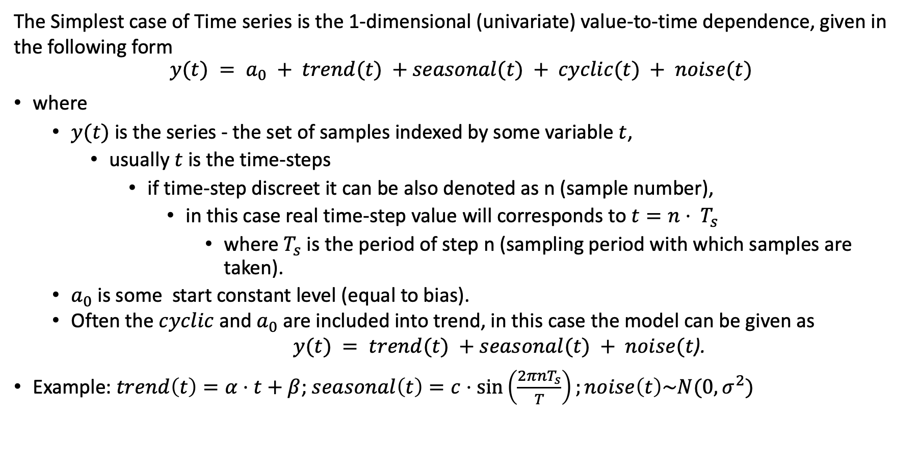
Time Series Models
The Simplest case of Time series is the 1-dimensional (univariate) value-to-time dependence, given in the following form
$$y(t) = a_{0} + trend(t) +seasonal(t) + cyclic(t) + noise(t)$$
where
$y(t)$ is the series - the set of samples indexed by some variable $t$,
usually $t$ is the time-steps
if time-step discreet it can be also denoted as n (sample number),
in this case real time-step value will corresponds to $t=n⋅ T_{s}$
where $T_{s}$ is the period of step n (sampling period with which samples are taken).
$a_{0}$is some start constant level (equal to bias).
Often the $cyclic$ and $a_{0}$are included into trend, in this case the model can be given as
$y(t) = trend(t) +seasonal(t) + noise(t$).
Example: $trend\left(t\right)=α⋅t+β$; $seasonal\left(t\right)=c⋅\sin\left(\frac{2πnT_{s}}{T}\right);noise\left(t\right)\sim N(0,σ^{2})$

Slide 12
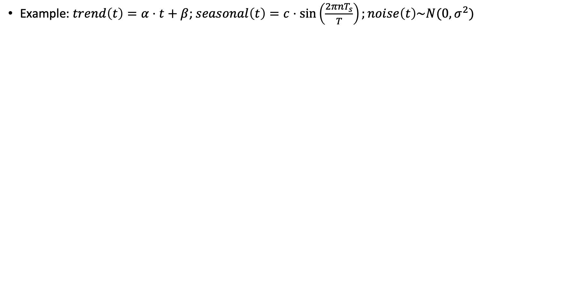
Time Series Models
Example: $trend\left(t\right)=α⋅t+β$; $seasonal\left(t\right)=c⋅\sin\left(\frac{2πnT_{s}}{T}\right);noise\left(t\right)\sim N(0,σ^{2})$

Slide 13
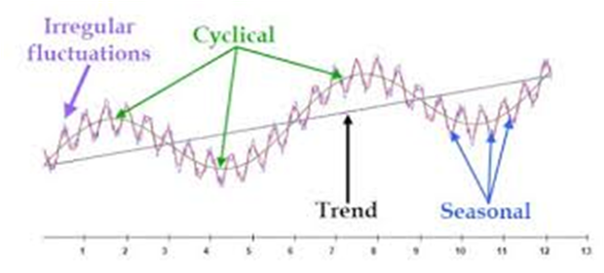
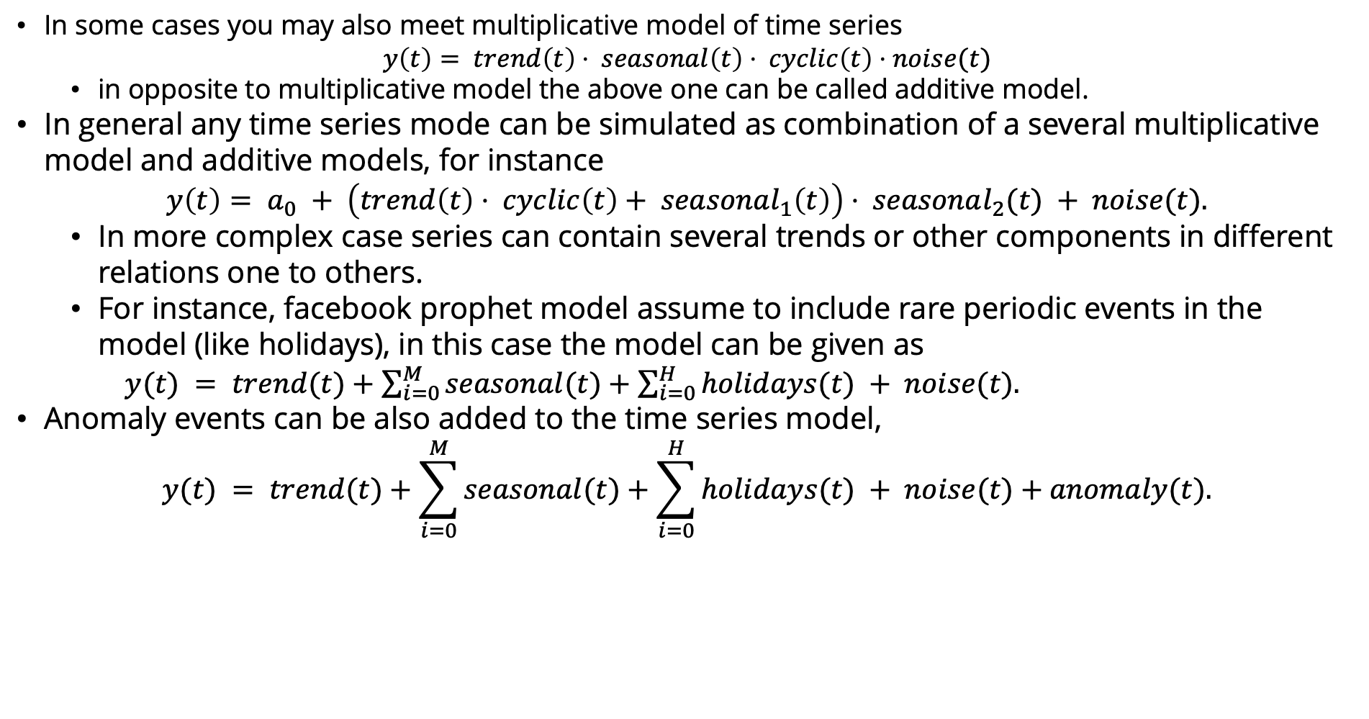
Time Series Models. Notes
In some cases you may also meet multiplicative model of time series
$$y\left(t\right)= trend\left(t\right)⋅ seasonal\left(t\right)⋅ cyclic\left(t\right)⋅noise(t)$$
in opposite to multiplicative model the above one can be called additive model.
In general any time series mode can be simulated as combination of a several multiplicative model and additive models, for instance
$$y\left(t\right)= a_{0} + \left(trend\left(t\right)⋅ cyclic\left(t\right)+ seasonal_{1}\left(t\right)\right)⋅ seasonal_{2}(t) + noise(t).$$
In more complex case series can contain several trends or other components in different relations one to others.
For instance, facebook prophet model assume to include rare periodic events in the model (like holidays), in this case the model can be given as
$y(t) = trend(t)+\sum_{i=0}^{M}{seasonal(t)}+\sum_{i=0}^{H}{holidays(t)} + noise(t).$
Anomaly events can be also added to the time series model,
$$y(t) = trend(t)+\sum_{i=0}^{M}{seasonal(t)}+\sum_{i=0}^{H}{holidays(t)} + noise(t)+anomaly(t).$$

Slide 14
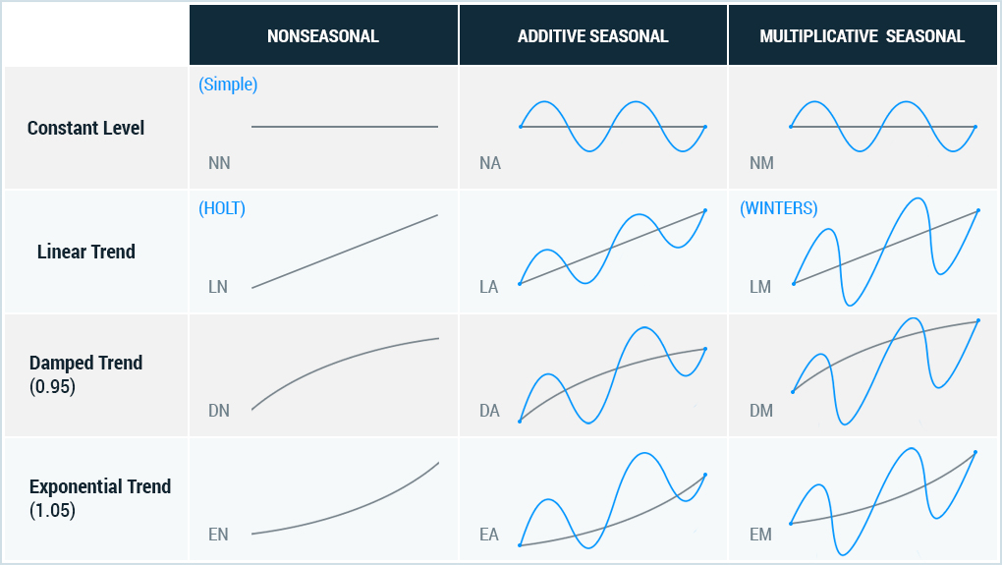
Examples of additive and multiplicative seasonality on trend

Slide 15
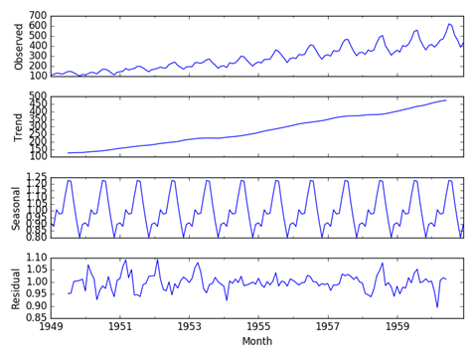
Examples of additive and multiplicative seasonality on trend
As a rule, the time series can present (decomposed) into its main components by methods of the time series analysis.
The study of methods of time series analysis is the subject of our course.

Slide 16
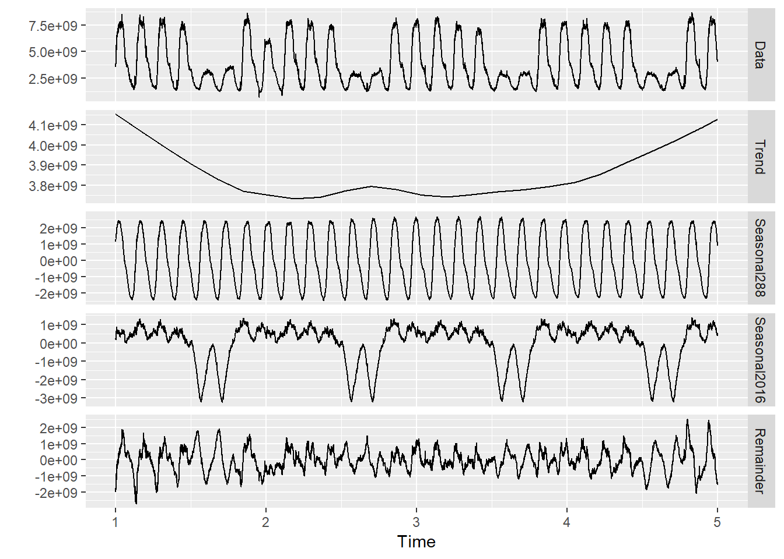
Examples of multi-seasonality

Slide 17
Examples of multi-seasonality
The interpretation of data features as time series components depends on our goal. Before make decision about time series model we need to make and check a several hypotheses.
For instance, lets considering the price of Bitcoin. If we wont to predict a day-change of the price we will considering the several hour-changing as seasonality, a week change as trend, a day-change as cyclic components and a minute change as noise. But if we wan to estimate a month price, than the day change will be considered as a noise part, and also we can we can identify several trends (or trend with time dependence!).
Thus, the first task in the time series analysis (at least in its classical form) is to introduce the model of the series. Ideally we need to have the full formally described model of the series, but at least we need to have the trend model (and, or including cyclic part).​

Slide 18
Examples of multi-seasonality
The main parts of the time series are the trend and seasonality. When we have some data first thing we need is to determinate the trend part. The following things are important about the trend.
Frequently we do not know how to approximate trend the best expect of linear trend.
The error of the trend approximation have main influence on the error of the time series prediction or its parameters estimation.
For most of the real-world series, the trend is not the monotonic growing (or falling) function.
The trend can have inflexion points and/or saturation parts which are necessary to be predicted with the most accuracy (for instance, see currency price prediction graphic above).
The piecewise-monotonic behavior is natural for many real-world processes, thus it is most important to identify the inflection point If trend has a complex form it could be hard to distinguish it in series.
In many cases the cyclical part of the series can be considered either as its complex trend or its seasonality.
The deterministic trend can be affected by several random effects, such as a random walk and drift. In this case sometimes we will need to talk about stochastic trend. These effects, in fact, can be considered as noise but mostly influencing only on the trend part.

Slide 19
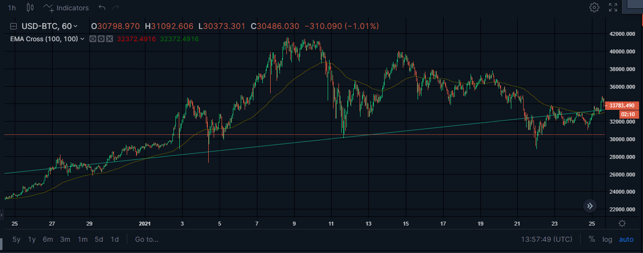
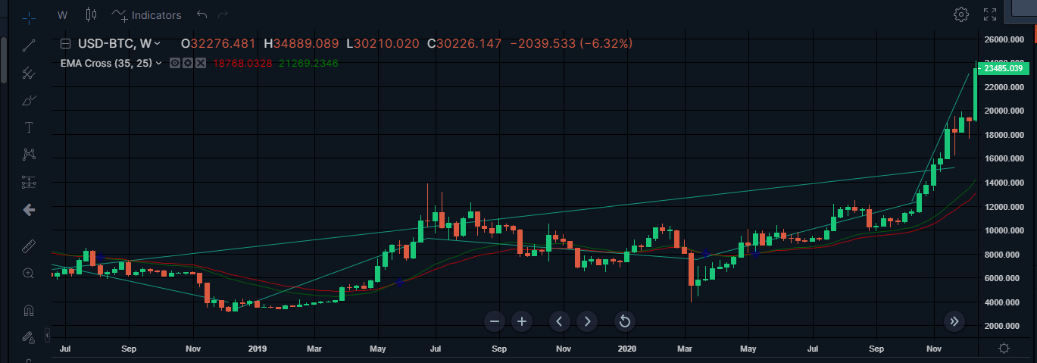
Examples of Time series interpretation
Daily change
Monthly change

Slide 20
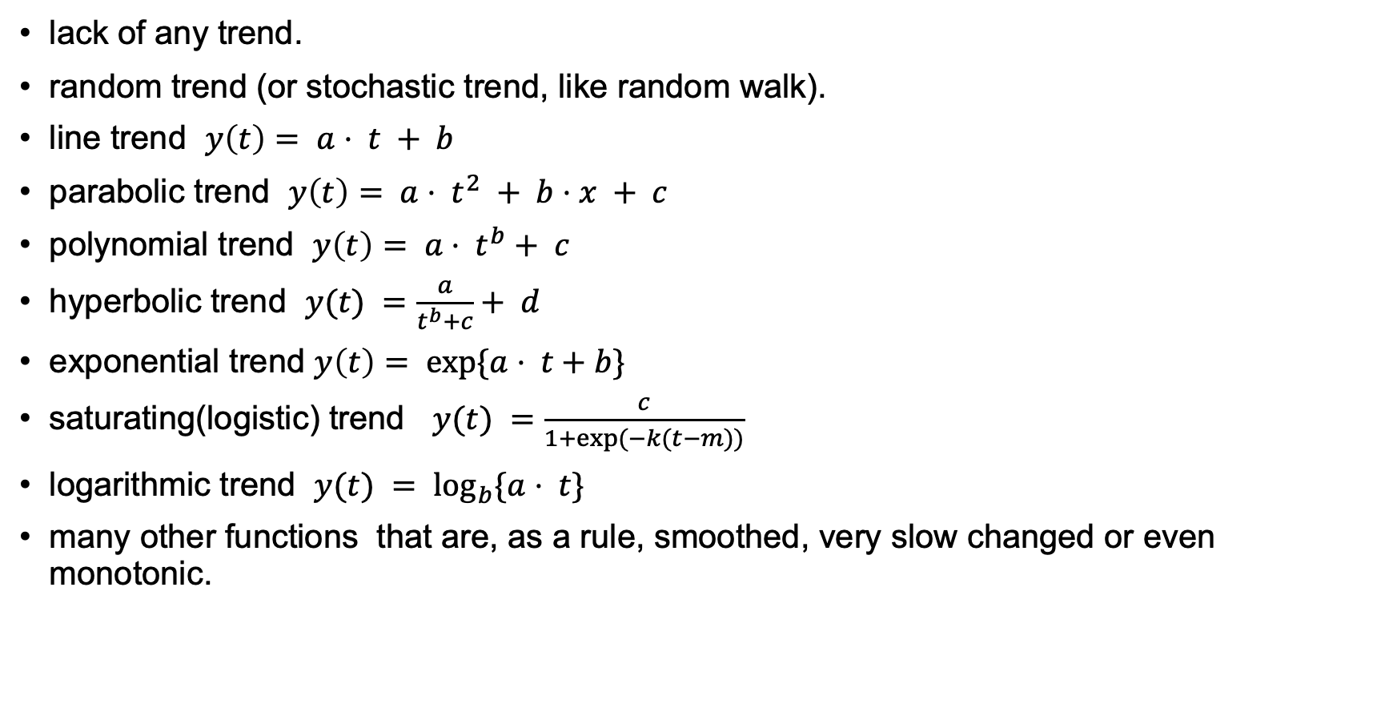
Popular types of Time series trend
lack of any trend.
random trend (or stochastic trend, like random walk).
line trend $y\left(t\right)= a⋅ t + b$
parabolic trend $y\left(t\right)= a⋅ t^{2} + b⋅x + c$
polynomial trend $y\left(t\right)= a⋅ t^{b}+ c$
hyperbolic trend $y(t) =\frac{a}{t^{b}+c}+ d$
exponential trend $y\left(t\right)= exp\{a⋅ t+b\}$
saturating(logistic) trend $y(t) =\frac{c}{1+exp⁡(−k(t−m))}$
logarithmic trend $y(t) = \log_{b}\{a⋅ t\}$
many other functions that are, as a rule, smoothed, very slow changed or even monotonic.

Slide 21
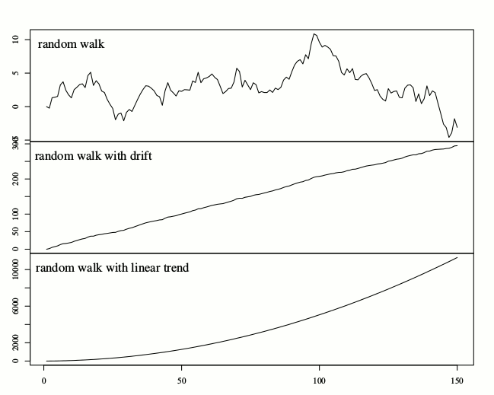
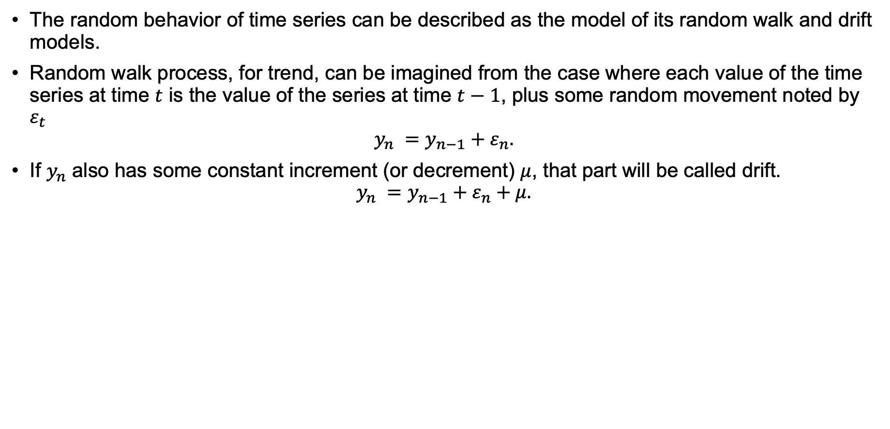
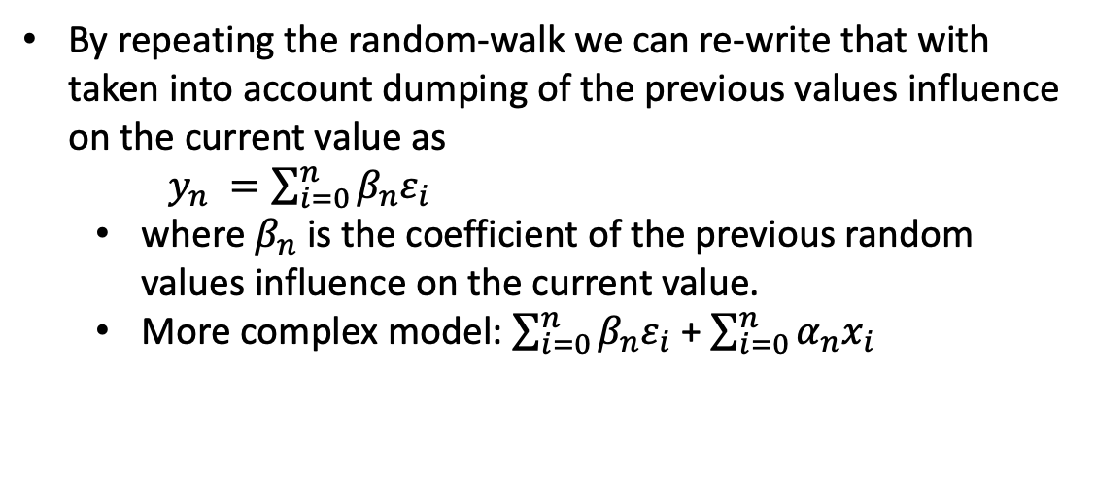
Random behavior of time series trend
The random behavior of time series can be described as the model of its random walk and drift models.
Random walk process, for trend, can be imagined from the case where each value of the time series at time $t$ is the value of the series at time $t−1$, plus some random movement noted by $ε_{t}$
$$y_{n} =y_{n−1}+ε_{n}.$$
If $y_{n}$ also has some constant increment (or decrement) $μ$, that part will be called drift.
$$y_{n} =y_{n−1}+ε_{n}+μ.$$
By repeating the random-walk we can re-write that with taken into account dumping of the previous values influence on the current value as
$y_{n} =\sum_{i=0}^{n}{β_{n}ε_{i}}$
where $β_{n}$is the coefficient of the previous random values influence on the current value.
More complex model: $\sum_{i=0}^{n}{β_{n}ε_{i}}$ + $\sum_{i=0}^{n}{α_{n}x_{i}}$

Slide 22
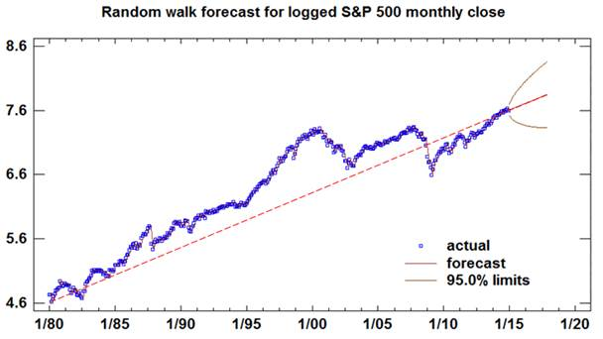
Example of random walk and drift of trend

Slide 23
Type of Time Series Representation
Univariate analysis is the simplest form of time series analysis where the data being analyzed contains only one variable.
Bivariate analysis is slightly more complex case than Univariate analysis. When the data set contains two variables both indexed by time and researchers aim to undertake comparisons between the two data or predict both.
Multivariate analysis is a more complex form of time series analysis technique and used when there are more than two variables in the data set.
Analysis with exogenous factors(covariate) is form of time series analysis when we suppose that the analyzed data depends on some other data and time indexes.
The covariate factors can be considered as a priory information for analyzed series.
Covariate factors are influence indirectly on the aim variable.

Slide 24
Type of Time Series Representation
Data Time Features: these are components of the time step itself for each observation.
Lag Features: these are values of current and prior time steps.
For instance, you are predicting the stock price for a company. So, the previous day’s stock price is important to make a prediction.
In other words, the value at time t is greatly affected by the value at time t-1. The past values are known as lags, so t-1 is lag 1, t-2 is lag 2, and so on.
Window Features (segments): these are a summary of values over a fixed window of prior time steps.
Segments could be with crossing of values or without it.

Slide 25
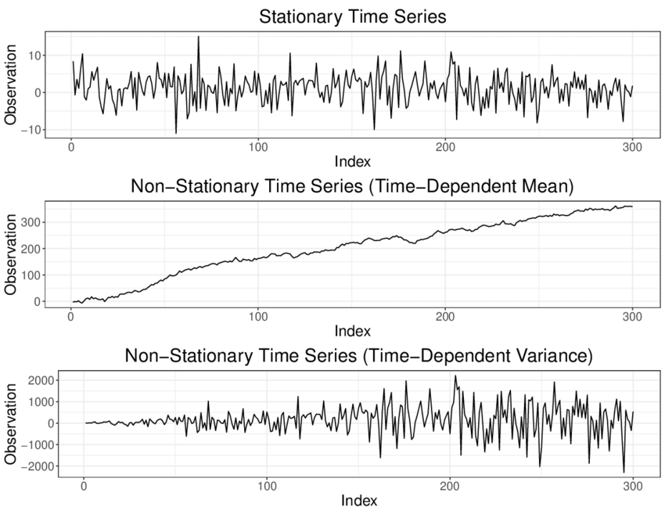
Time Series Types
Stationary series in strong meaning, when the series parts are the same with no matter in which moment the part is taken.
In weak definition Stationary series it is the series in which you have constant mean and variance.
Non-stationary series if different parts of the series differ, for instance, when the spread of sample values change.

Slide 26
Time Series Types
Linear series model when components of the series have linear or reduced to linear relations.
As a rule, for linear model we can say about certain simple relations, frequently with equidistant time stamps and without empty values and so on.
For linear model we can introduce some known analytical or heuristically-analytical model of time series.
For linear model we can distinguish and formally describe some patterns in behavior.
Non-linear series model when components of the series have complex or non-linear relations with each other.
As a rule, for Non-linear model we can not say about certain patterns.
Unstructured series - series with no obvious systematic time-dependent pattern in a time series variable.
As particular cases: random-trend (or stochastic trend) and random-seasonality.
Structured series - series with systematic time-dependent patterns in a time series variable (e.g. trend and/or seasonality).
As particular cases: deterministic trend and deterministic seasonality.

Slide 27
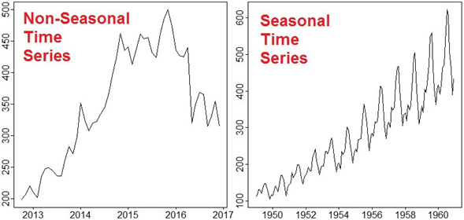
Time Series Types
Seasonal series the data have some periodic patterns, in general fixed period is not necessary, for instance dependence of values per week).
Non-seasonal series when data have a no-periodic pattern or not-known behavior.

Slide 28
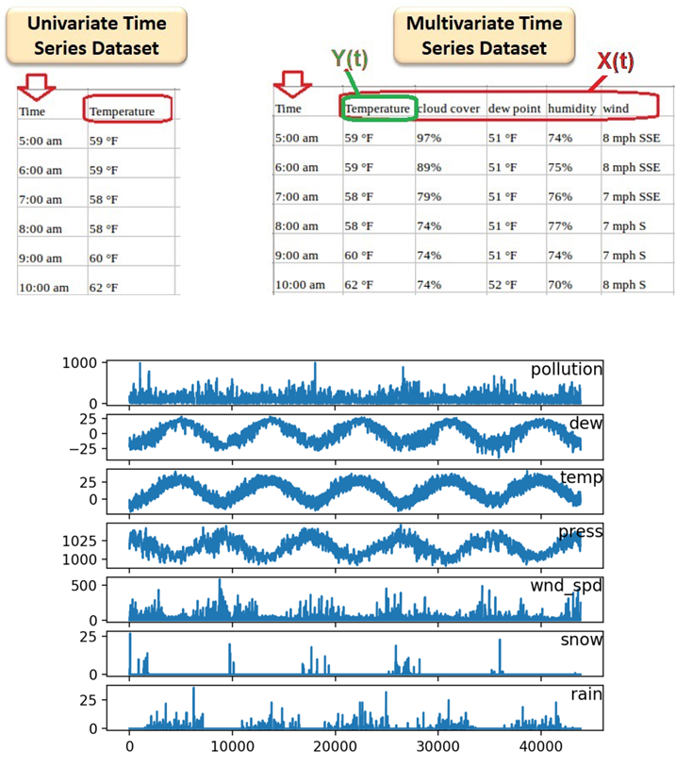
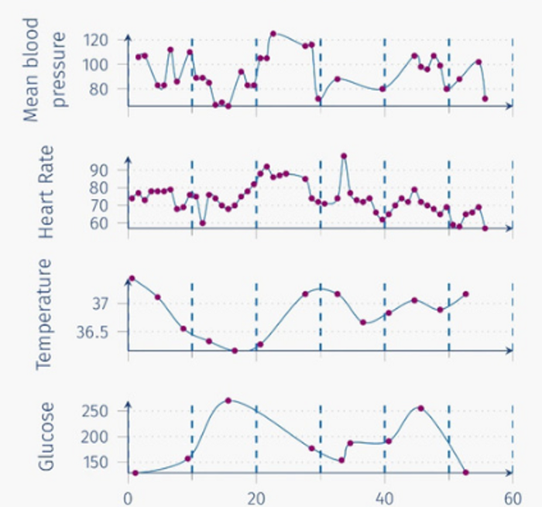
Examples of Multivariate Time Series
Example of multivariate time series with measurements that are taken at a different frequency and irregular times, probably with missing values.

Slide 29
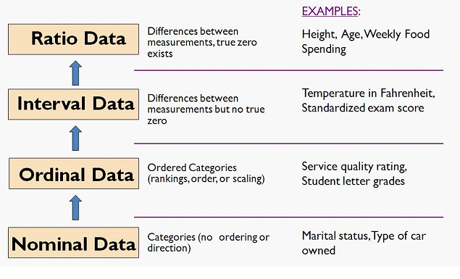
Time Series Data Types

Slide 30
Examples of Time Series Analysis Tasks
Main time series analysis tasks:
forecast future values in the series (could be as out-of-samples forecasting, as in-samples prediction).
series parameter estimation. For instance, the period of seasonality (or cyclicity), the slope of the trend.
anomaly detection.
patterns in series recognition and classification.
time-series segmentation
incomplete series reconstruction (if some data are missing).
time series pattern clustering (unsupervised task).
Auxiliary time series analysis tasks:
series denoising.
series transformation. Non-linear transformation for better representation of time series, the simplest are derivative, logarithm transforms.
series decomposition. Some components extraction, for instance complex trend reconstruction.
series re-discretization and re-quantization. For instance, if we have series with non-uniform steps or for dimension reduction.
​ Try to make some initial hypothesis about way of analysis based on the task.

Slide 31
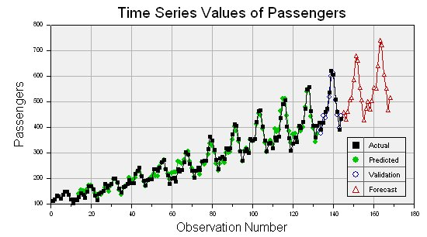
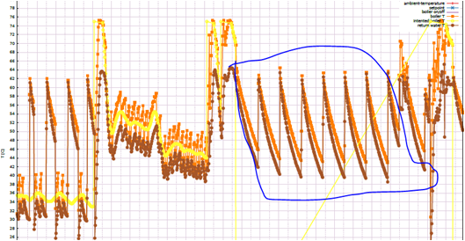
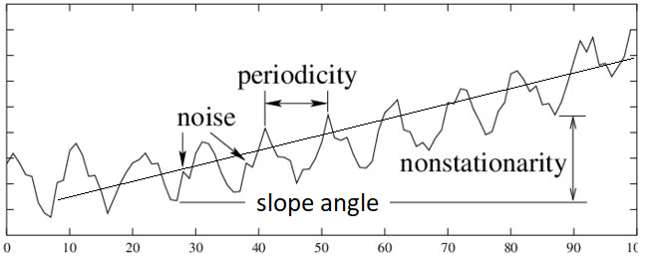
Examples of Time Series Analysis Tasks
Time series forecast
Time series pattern recognition
Time series Parameters estimation

Slide 32
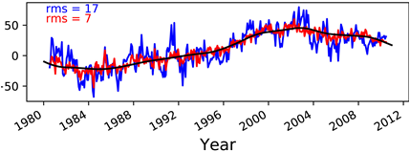
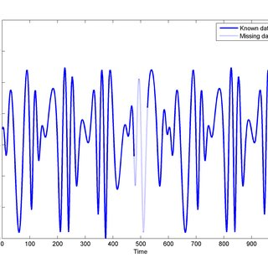
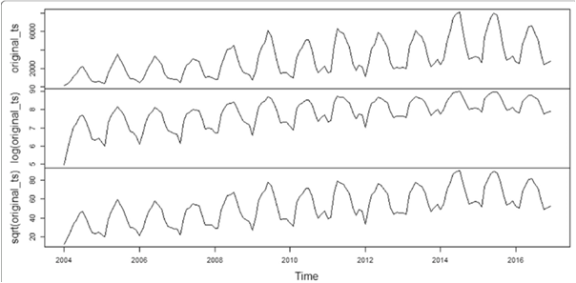
Examples of Time Series Analysis Tasks
Time series denoising
Incomplete time series reconstruction
Time series transformation

Slide 33
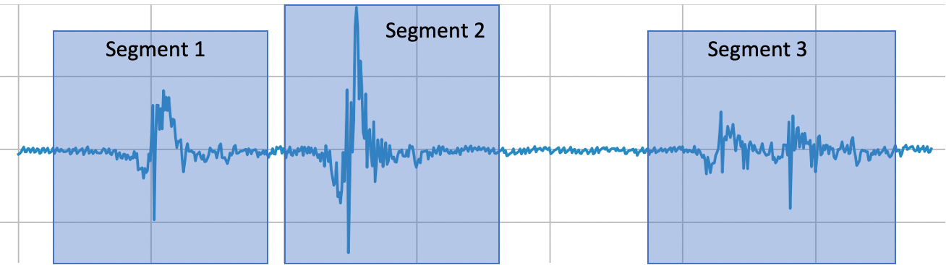
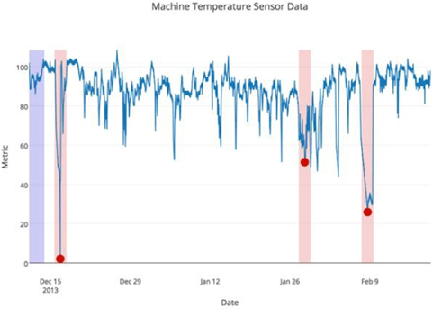
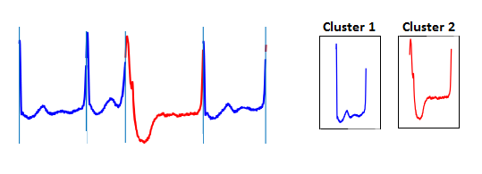
Examples of Time Series Analysis Tasks
Time series segmentation
Time series Anomaly detection
Time series Clustering

Slide 34
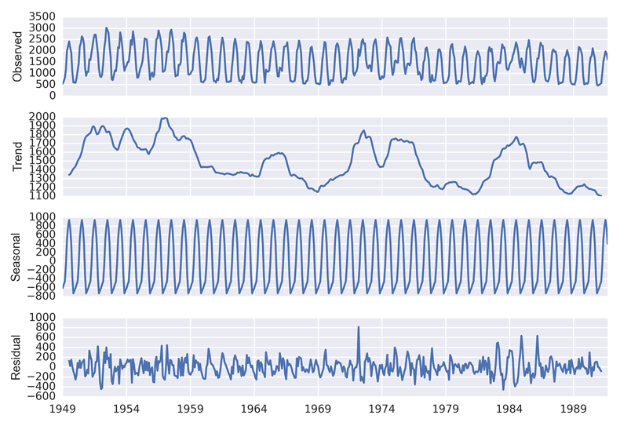
Examples of Time Series Analysis Tasks
Time series decomposition

Slide 35
General about time series model
General notes about time series model
Try to visualize time series.
Assume about exogenous factors, univariate or multivariate consideration of time series.
Make a one or several assumptions about linearity of the model.
Make a one or several assumptions about description of the model (trend, seasonal parts, dumped trend, saturation, inflection points and e.t.c.).
Assume about linearity of the model component relation.
Assume about stationarity of the model.
Check your hypothesis to find the best suit one.

